Slide 1
12. Deep Learning - CNN

Slide 2
Convolutional Neural Networks

Slide 3
Convolutional Neural Networks (CNNs)
CNNs were primarily designed for image data
CNNs use a convolutional operator for extracting data features
Allows parameter sharing
Efficient to train
Have less parameters than NNs with fully-connected layers
CNNs are robust to spatial translations of objects in images
A convolutional filter slides (i.e., convolves) across the image

Slide 4
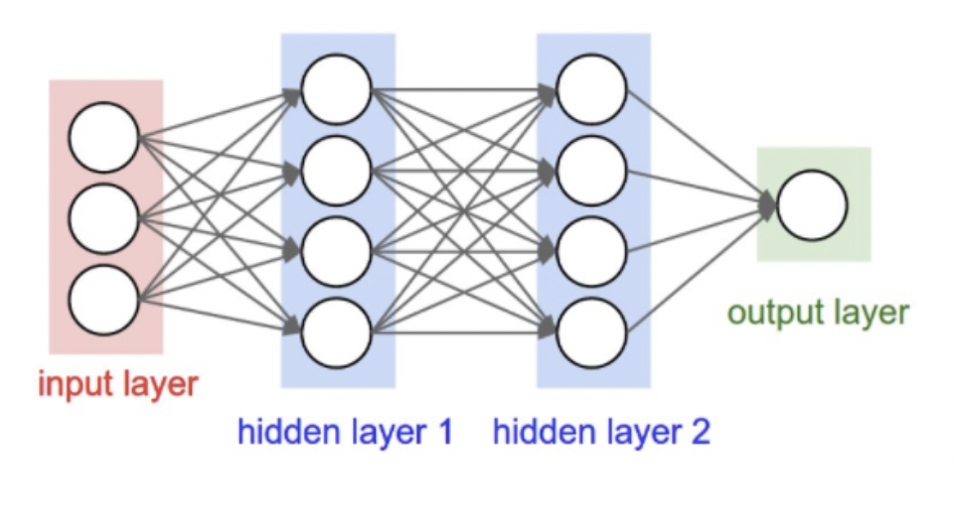
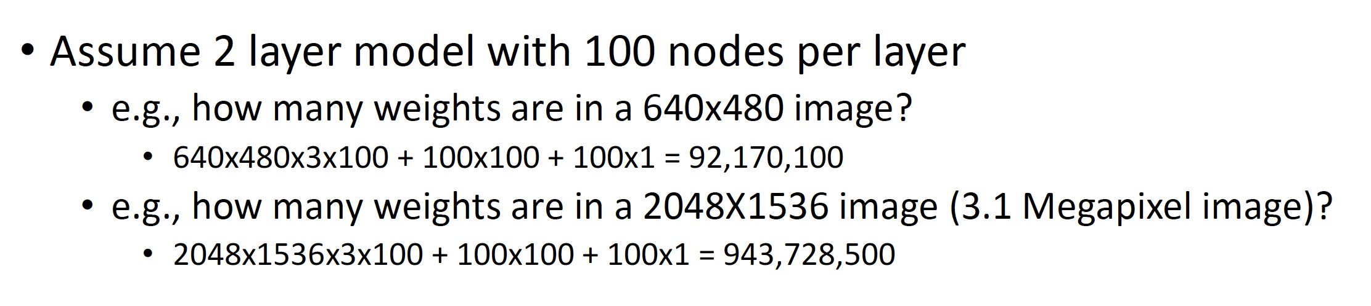
Recall: Fully connected NN

Slide 5
Recall: Fully connected NN
What are the weaknesses of fully connected NN?

Slide 6
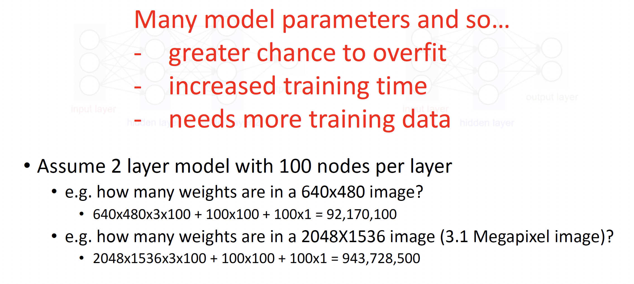
Recall: Fully connected NN

Slide 7
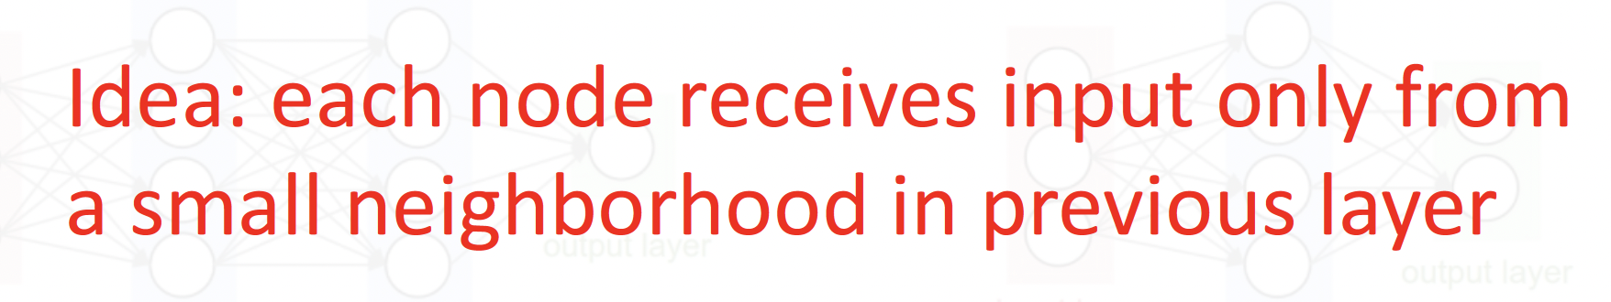
Convolutional Layer

Slide 8
Convolutional layer: parameters to learn
Parameter sharing
Reduces the number of weights to learn and so storage requirement
Sparse connectivity
Reduces the number of computational opertions required

Slide 9
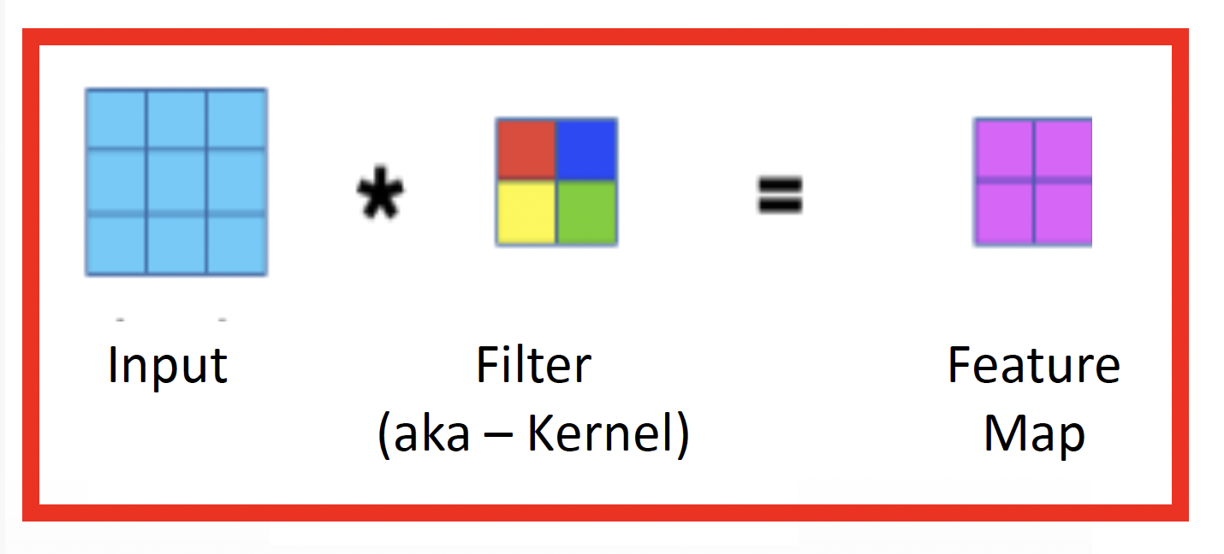
Applies linear filter

Slide 10
Image filtering
Computer a function of the local neighborhood for each pixel in the image
A filter specifies the function about how to combine neighbors’ values

Slide 11
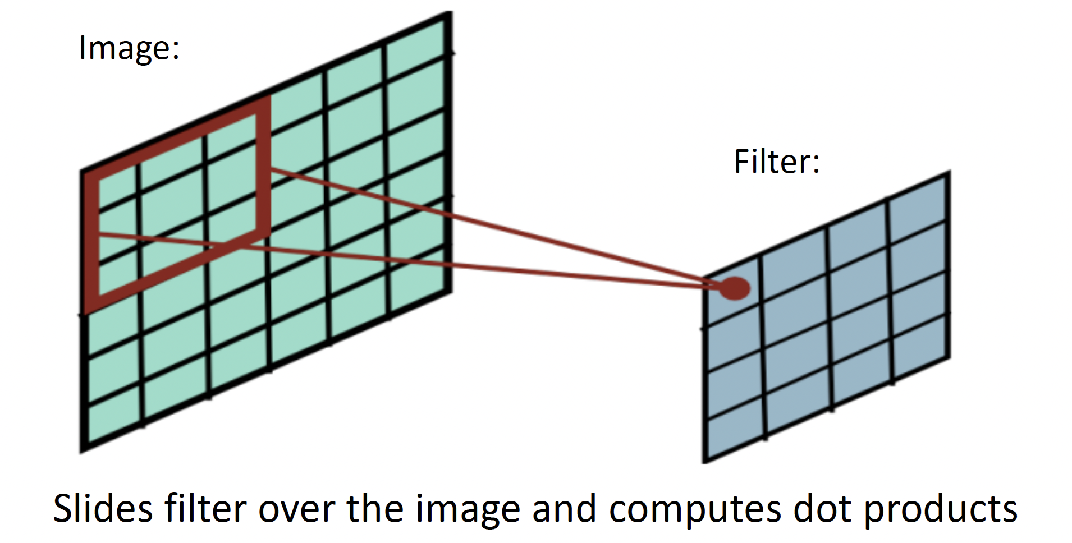
Image filtering

Slide 12
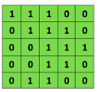

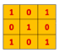
Image filtering: example
Convolutional
3x3 filter
Input matrix

Slide 13
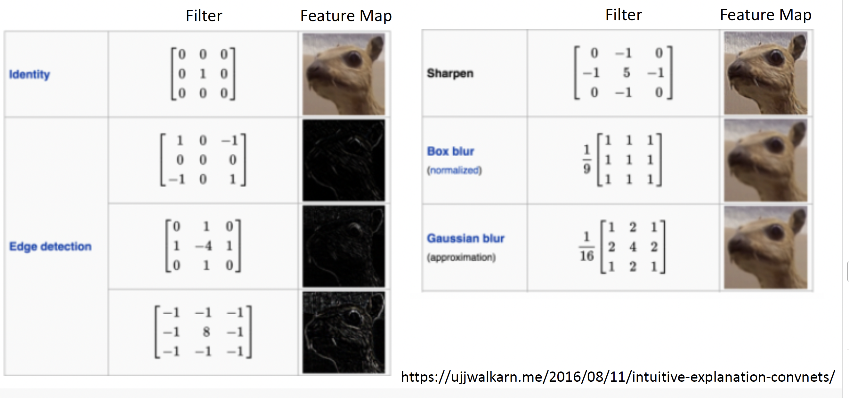

Slide 14
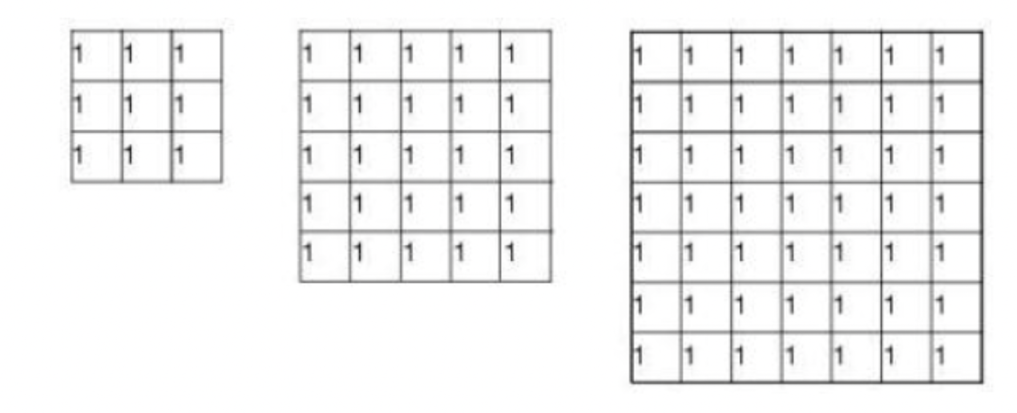
Group discussion 1
Why would you choose a larger versus a smaller filter?

Slide 15
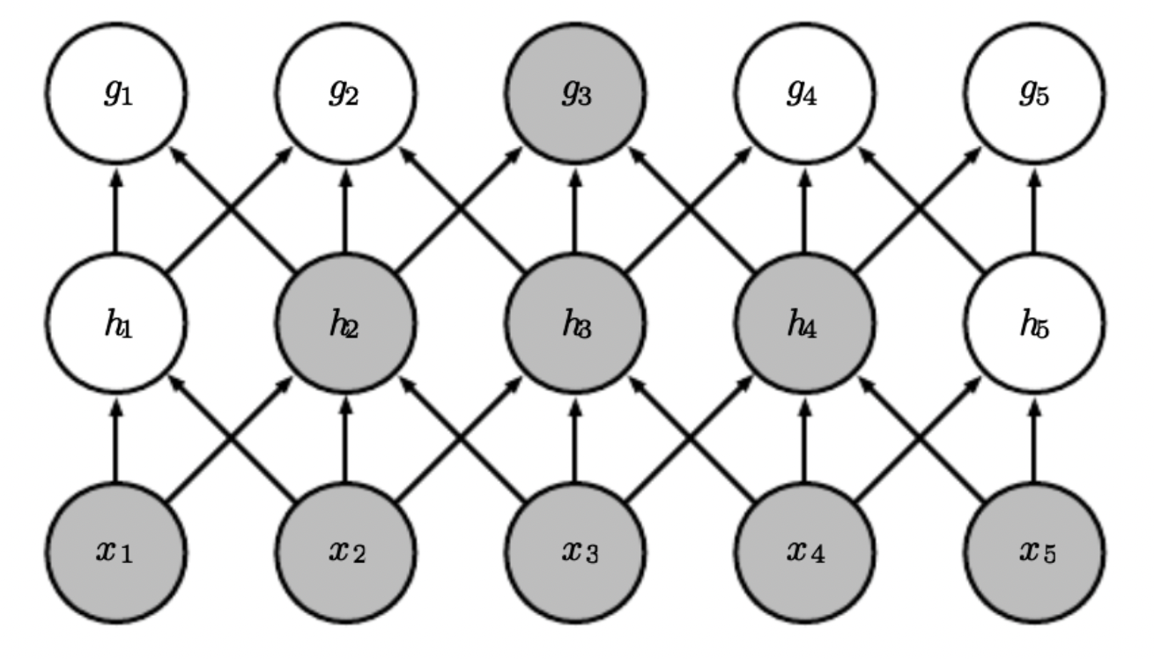
CNN
Stacking many convolutional layers leads to learning patterns
in increasingly larger regions of the input (i.e., pixel) space

Slide 16
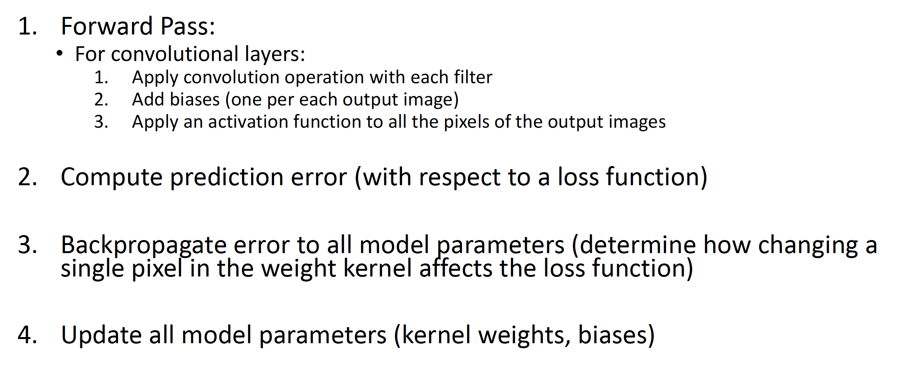
Convolutional Layer: Training

Slide 17
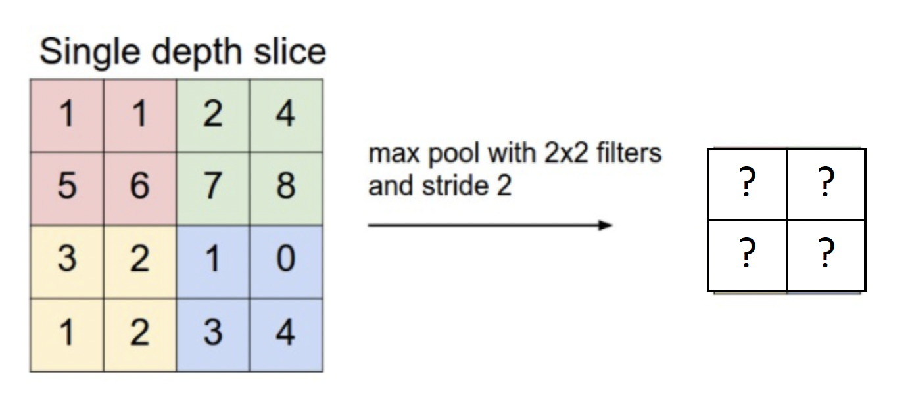
Pooling Layer
Summarizes neighborhood
Partitions input into a set of non-overlapping rectangles and outputs the max. value for each chunk

Slide 18
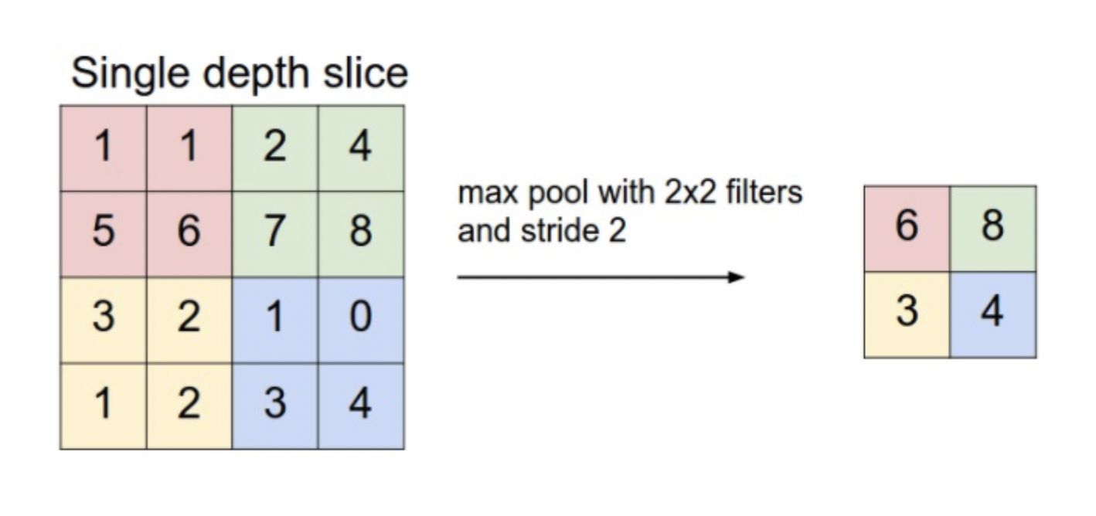

Slide 19
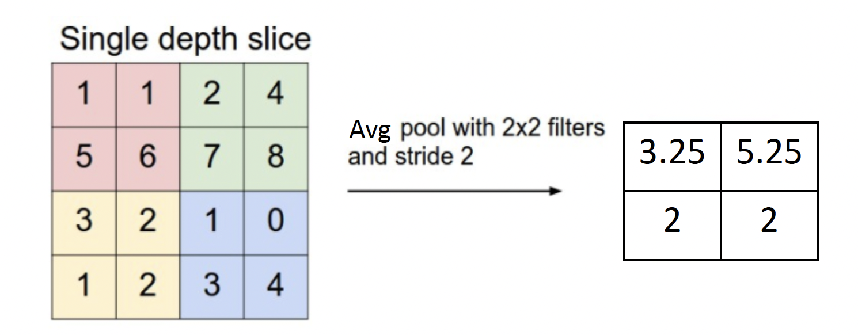
Pooling
Max pooling
Average pooling

Slide 20
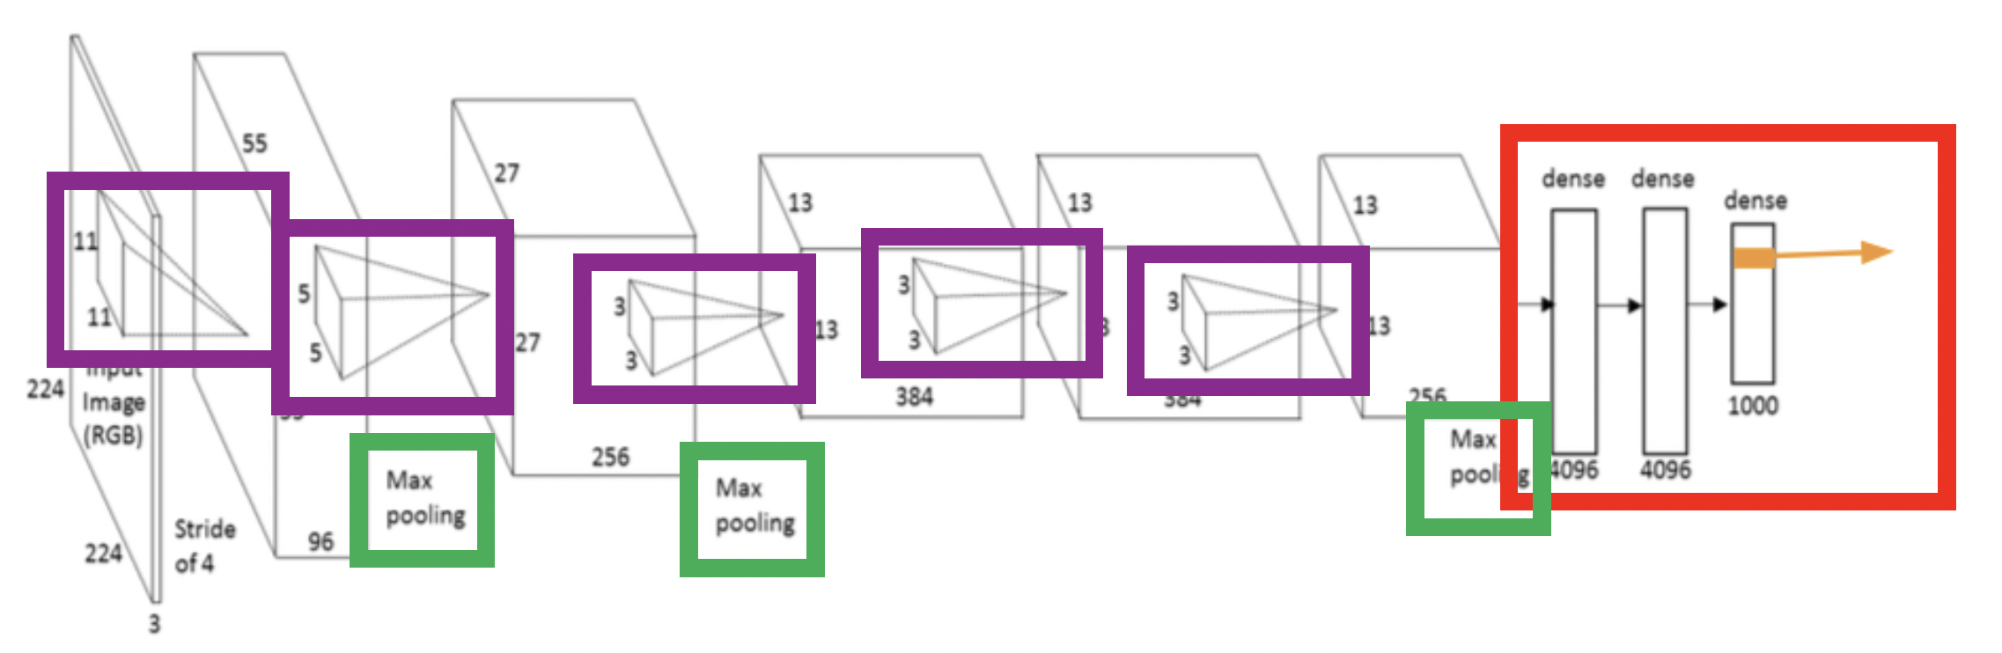
Summary of Convolutioal Layers

Slide 21
Group discussion 2
Why choose a larger vs. smaller stride size?

